Slide 1

Best Steam Games
Group 9: Cindy Huang, Lan Bowen, Manoj Kamalumpundi

Slide 2

Project Goal
A. What game was the most highly recommended game
B. Find keywords that gives a game a good review
C. Find out the sentiment of the video games, whether a game was overall positive reviews, or negative reviews
D. Find out the average number of hours played for each game.

Slide 3
Description of Dataset:
The dataset is from (https://www.kaggle.com/luthfim/steam-reviews-dataset) that contains a list of video game reviews from the popular video game site STEAM. The size of the file is 121 MB and the license is listed as a public domain. This dataset contains reviews from STEAM’s best selling games as of February 2019. The file has 434,891 rows and 8 columns. Title - game title being reviewed

Slide 4

The techniques Used to create the Project Report
1) Review data:
Import .csv data using encoding “utf8” and pipe separate
df= pd.read_csv("steam_reviews2.csv",encoding="utf8",sep='|', delimiter=None)
Because the dataset was so large, we took a random sample of 2000 reviews.
2) C lean up data:
Replace all non-English letters with empty string
Utilized SQL within Python to remove any rows with NaN

Slide 5
Check DTM Matrix before Text Visualization
Apply stemming using the Snowball stemmer from nltk and remove stop words in the stop word list of ntlk library without changing the size of vocabulary.
Select the most 20 common words in the reviews. They are “game, play, get, fun, good, like, time, don’t, make, peopl, player, great, friend, one, even, buy, realli, server, still, want”. Seem like positive words from the reviews. (Answer question b in project goal)

Slide 6
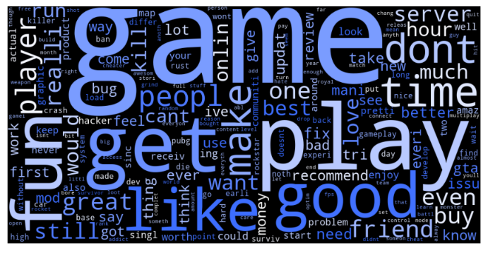
Text Visualization
This wordcloud contains both positive and negative words from the reviews.

Slide 7
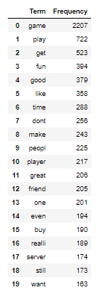
Text Visualization Continue
Create a DTM in term frequencies using CountVectorizer, StemmedCountVectorizer and vectorizer.fit_transform before doing Visualization

Slide 8
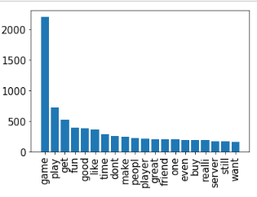
Text Visualization Continue
Create a bar chart for these most common words

Slide 9
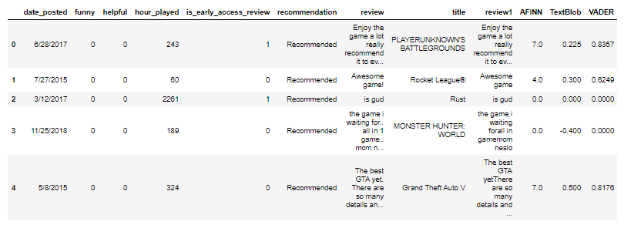
Text Visualization Continue
Apply AFINN, TextBlob and VADER and generate the correlations matrix to see how the sentiment scores of these reviews.
Text Visulaization Continue
Apply AFINN, TextBlob and VADER and generate the correlations matrix to see how the sentiment scores of these reviews.

Slide 10
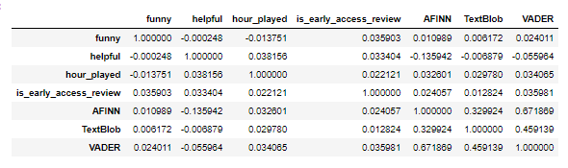
Text Visualization Continue
Generate the correlations matrix of different sentiment scores

Slide 11
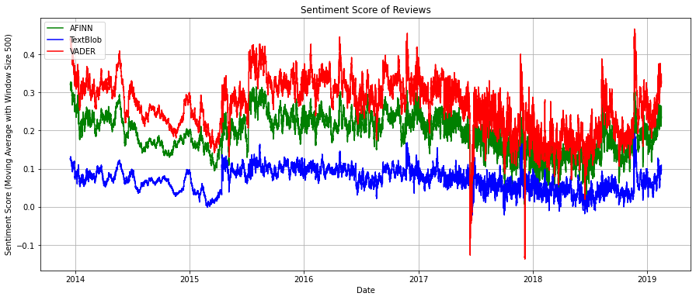
Sentiment Score of Reviews
Plot the sentiment score of a moving average of 500 sentiment scores of the reviews (all 400k+ used)
AFFINN (Scaled)
TextBlob
VADER

Slide 12
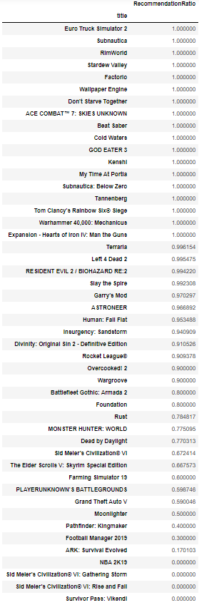

Summary Statistics
There are 2 reviews do not have recommendations. There are 633 Not Recommended and 1365 Recommendations out of 2000 reviews.

Slide 13
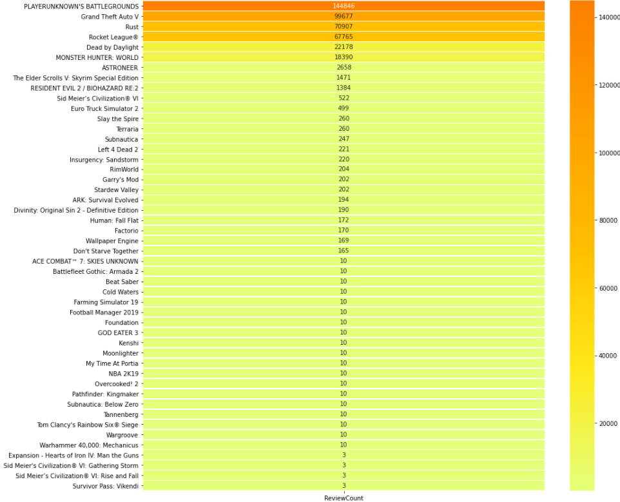
Summary Statistics continue
Use seaborn to create a mapplot for the number of reviews in each game (all reviews used)

Slide 14
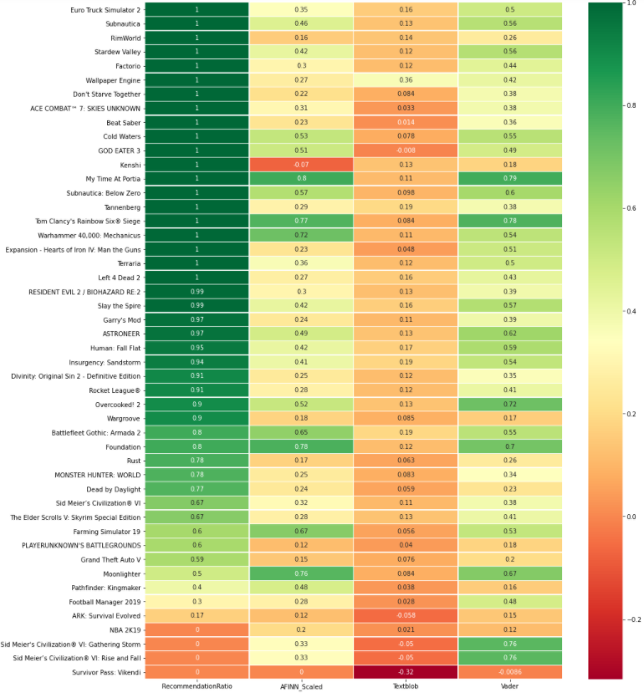
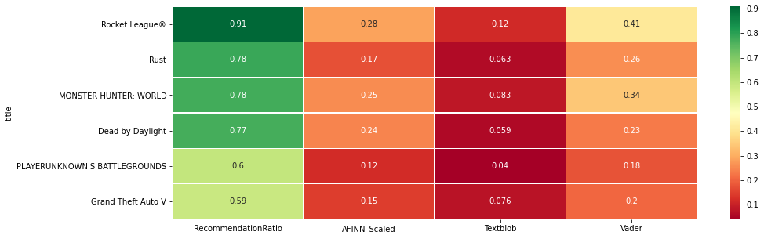
Sentiment Score: (Answer question c in the project goal)
Find out the sentiment of the video games, whether a game was overall positive reviews, or negative reviews:
Smaller reviews are more highly recommended
Textblob shows most consistent trend

Slide 15
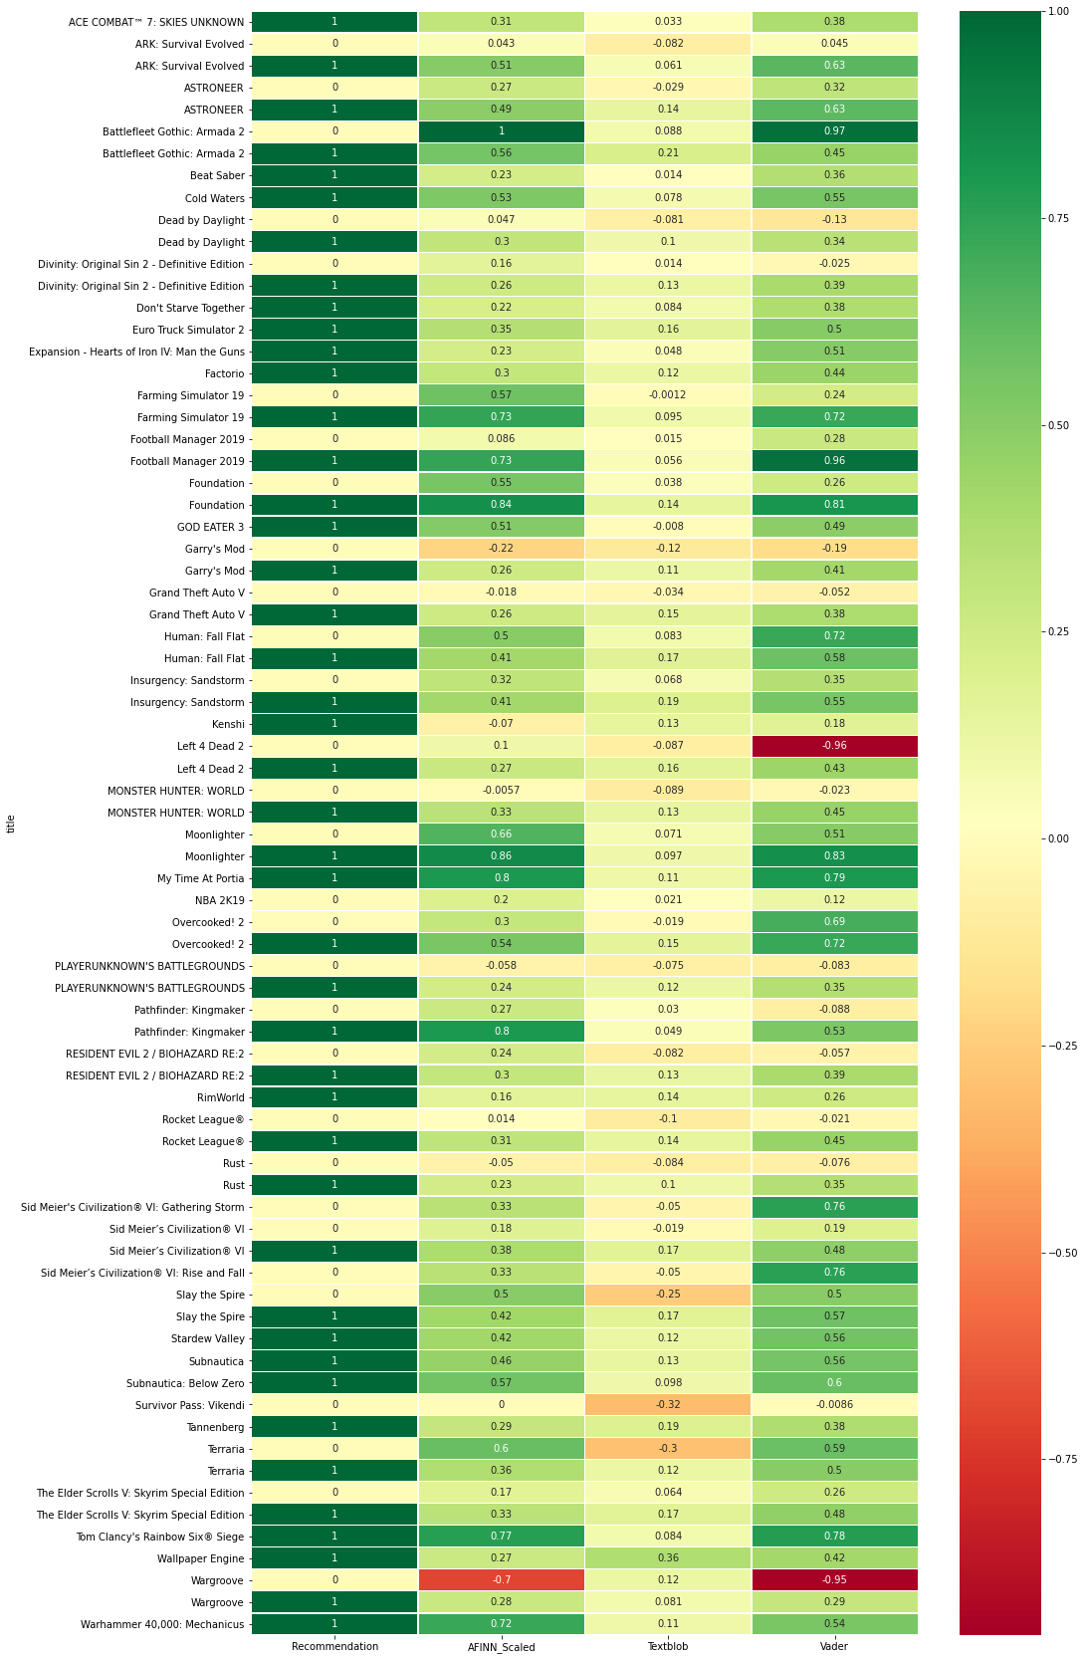
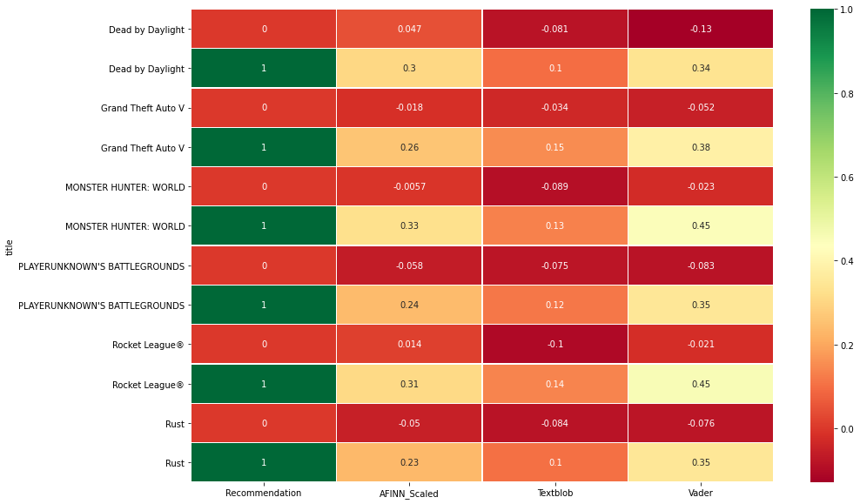
Sentiment Scores by recommend score

Slide 16
Text Blob had the best resolution in identifying positive/Negative Reviews
Recommended games generally had higher sentiment scores than non-recommended games
Multiple reviews needed to prevent skew of sentiment scores (Top 6 games)
Exceptions were cause because people couldn't vote on a neutral/meh review and told detailed that were good about the game more than the negative
Sentiment Score Summary

Slide 17
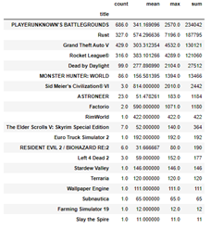
Average number of hours played for each game:

Slide 18
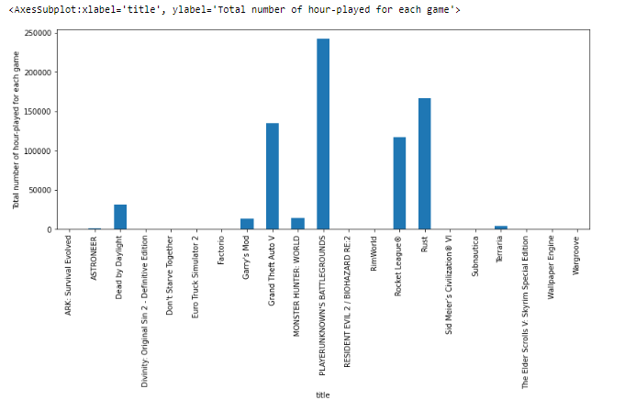

Slide 19
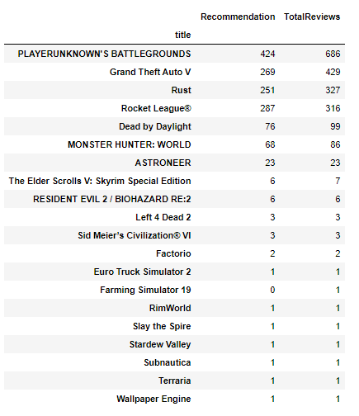
Number of Reviews for each game:
The Player Unknown Battlegrounds has the largest number of reviews
The total number of hour-played by reviewers is 241,898 hours.
Most popular game

Slide 20
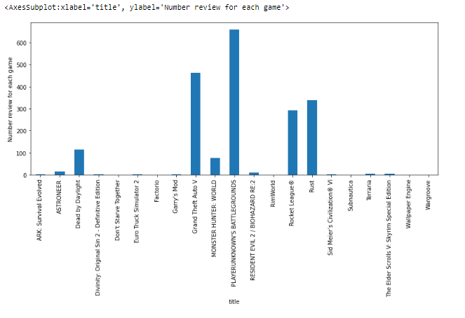
Number reviews for each game:

Slide 21
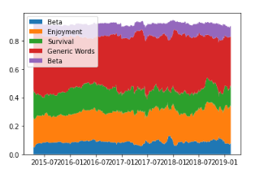
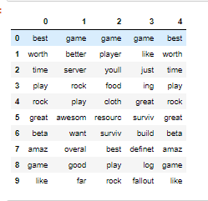
Topic Model
Topic 1: Beta
Topic 2: Enjoyment
Topic 3: Survival
Topic 4: Generic words
Topic 5: Beta

Slide 22
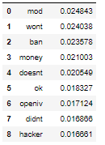

Prediction Model
Decision Tree (XGBoost)
10 most important terms
Accuracy: 0.9463
AUC: 0.9835
Confusion Matrix:

